Slide 1
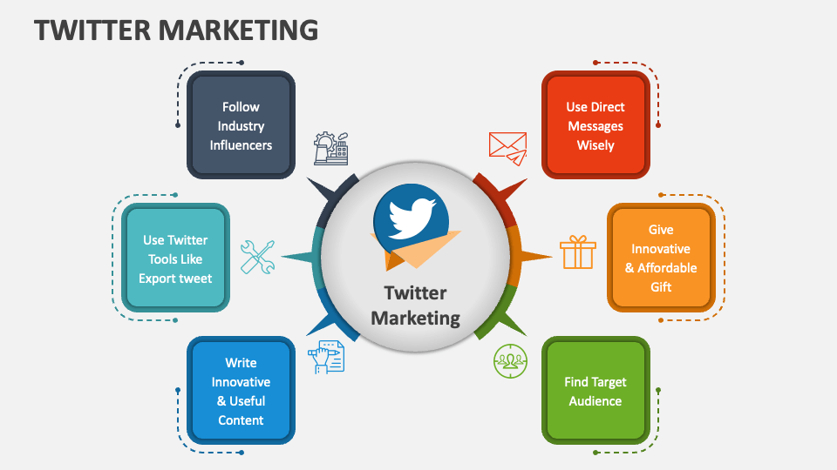
Twitter Marketing

Slide 2
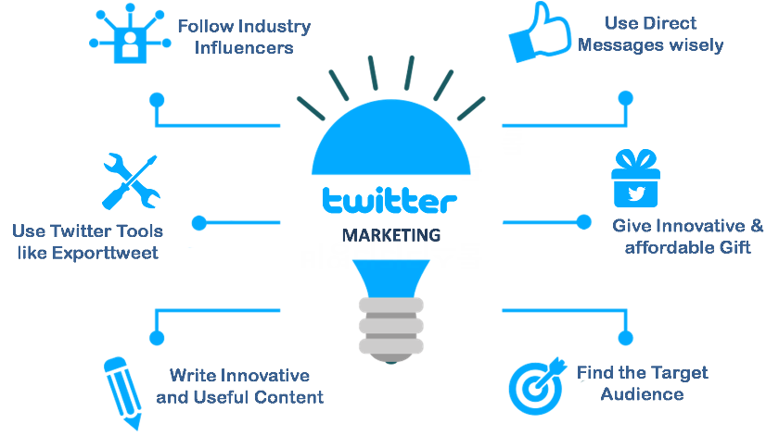
continue

Slide 3
Learning Objectives
- Understand Twitter’s marketing potential
- Build a Twitter-specific content strategy
- Use Twitter effectively for engagement
- Understand Twitter Ads and campaigns
- Create and analyze ad performance

Slide 4
Introduction to Twitter
Twitter (now X) marketing is the strategy of using the platform to promote a brand, product, or service by creating and publishing engaging content, interacting with users, and using advertisements to drive brand awareness, leads, and sales.
Key elements include developing a content strategy with engaging tweets and videos, participating in trending conversations, running targeted Twitter Ads, and analysing performance to refine the approach.
A successful strategy requires understanding the audience, creating consistent and valuable content, and engaging in real-time conversations.

Slide 5
Key Components of a Twitter Marketing Strategy
Platform Optimization:
Create a strong brand presence by choosing the right handle, profile picture, header image, and an optimized bio that reflects your brand's personality.
Content Strategy:
Content Creation: Share updates, videos, images, and participate in conversations. Use threads for longer-form content and polls to encourage interaction.
Timing: Post at peak hours to maximize engagement and reach.
Hashtags: Use relevant hashtags to increase visibility and join conversations.
Audience Engagement:

Slide 6
Continue
Interaction: Engage directly with followers by responding to questions and comments in real-time.
Community Building: Join and start Twitter chats or conversations to connect with your target audience.
Paid Advertising:
Twitter Ads: Utilize paid promotion options to reach a wider audience and grow your follower count.
Ad Objectives: Choose objectives like increasing awareness, getting website clicks, or generating leads.
Analysis and Optimization:
Performance Tracking: Use tools like Twitter Analytics to track key metrics such as engagement rate, follower growth, and web traffic.
Competitor Analysis: Monitor competitor accounts to understand their strategies and identify opportunities.

Slide 7
Benefits of Twitter Marketing
Wide Reach: Connect with a global audience and penetrate global markets.
Real-Time Engagement: Interact with customers instantly, which is ideal for events or product launches.
Enhanced Visibility: Gain visibility through trending topics, hashtags, and conversations.
Direct Customer Interaction: Address customer concerns and build relationships.
Cost-Effective: A platform with various ad products that can fit different budgets, offering a good return on investment.

Slide 8
Basics of Twitter Marketing
- Tweets, hashtags, retweets, threads, mentions
- Twitter threads for storytelling
- Trending topics for visibility

Slide 9
Building a Twitter Content Strategy
- Types: Text, polls, GIFs, videos, threads
- Tools: TweetDeck, Buffer
- Hashtags & timing
- Consistency and brand voice

Slide 10
Building a Twitter content strategy
A well-planned content strategy is the foundation of your Twitter marketing and requires careful planning and audience research.
Define your goals and audience
Identify objectives: Determine what you want to accomplish with your Twitter presence, whether it's increasing brand awareness, generating leads, or driving website traffic.
Understand your audience: Research your target audience's interests, pain points, and behaviors using Twitter Analytics or other tools to create content that resonates with them.

Slide 11
Create a content calendar
Develop a calendar that includes a mix of content types to keep your audience engaged. A typical strategy includes a balance of the following:
Promotional content: Share product updates, special offers, and company news.
Educational content: Post informative resources like blog posts, videos, or infographics.
Engaging content: Use interactive features like polls, questions, and Q&As to spark conversations.

Slide 12
Crafting effective tweets
Use visual content: Tweets with images, GIFs, and videos receive significantly higher engagement than text-only posts.
Incorporate hashtags: Use one or two relevant hashtags to increase your tweet's discoverability. Overusing them can appear spammy.
Add a strong CTA: Include a clear and compelling call-to-action to guide users to your desired outcome, such as "Shop Now" or "Learn More".
Utilize threads: For more in-depth content, use threads to tell a story or explain a topic across a series of connected tweets.

Slide 13
Using Twitter effectively
Beyond your core content, daily usage and active engagement are critical for building relationships and growing your brand.
Actively engage with your community
Respond promptly: Reply to mentions and direct messages in a timely manner. This demonstrates that your brand is active and attentive.
Participate in conversations: Join trending conversations and relevant Twitter chats using industry-specific hashtags. This helps position your brand as a thought leader.
Interact with others: Retweet or reply to content from followers and industry peers to build goodwill and foster relationships.

Slide 14
Leverage profile optimization
Use your brand voice: Ensure your company's personality comes through in your posts, whether it's humorous and casual like Wendy's or professional and insightful.
Complete your profile: Use a high-quality logo as your profile picture and write a concise bio with relevant keywords. Include your website link to drive traffic.

Slide 15
Using Twitter Ads for marketing
Twitter's advertising platform is an effective tool for amplifying your message and driving conversions beyond your organic reach.
Types of Twitter ads
Promoted Ads (Promoted Tweets): Regular tweets that you pay to promote to a wider audience. They appear in users' timelines and search results.
Follower Ads (Promoted Accounts): These ads are designed to gain more followers by promoting your entire profile to relevant users.
Promoted Trends: A more premium option where you can pay to place your hashtag at the top of the trending topics list.
Video Ads: Run short, highly-engaging video clips that can be promoted across the platform.

Slide 16
Running effective ad campaigns
Choose your objective: Twitter offers objective-based campaigns for goals like increasing awareness, driving website traffic, or boosting engagement.
Define your audience: Use Twitter's targeting options to reach the right people. You can target based on demographics, interests, keywords, or even specific user behaviors.
Optimize your creative: Use eye-catching visuals and a strong call-to-action. You can also A/B test different ad creatives to see what resonates best.
Monitor and adjust: Regularly track your campaign's performance using Twitter Analytics to evaluate key metrics like impressions, clicks, and engagement. Use this data to refine your strategy over time.

Slide 17
Twitter Ad Campaigns
1. Start with a Clear Strategy:
Begin by defining specific, measurable, and strategic goals for your campaign to guide your choices.
2. Use the Ads Manager:
This is the central platform for creating and managing your campaigns.
3. Choose Campaign Objectives:
Select the appropriate objective (e.g., engagement, website traffic, app installs) for your campaign within the Ads Manager.
4. Optimize Targeting and Budget:
Continuously adjust your budget and audience targeting based on campaign performance data to improve results and lower costs.

Slide 18
Twitter Analytics
1. Understand Your Goals & KPIs:
Identify the key performance indicators (KPIs) that directly relate to your campaign goals and track them regularly.
2. Monitor Key Metrics:
Pay attention to metrics such as cost per click (CPC), cost per acquisition (CPA), and conversion rates to assess ad spend efficiency and impact on revenue.
3. Regular Review and Implementation:
Frequently check your Twitter Analytics to gain real-time insights and make timely adjustments to your strategy and ad creatives.

Slide 19
Third-Party Twitter Tools
Management & Scheduling:
Tools like Sprout Social can help with project management and content scheduling.
Social Listening:
Mentionlytics and other social listening tools help monitor mentions, conversations, and industry trends.
Analytics & Reporting:
Tools such as SocialPilot provide advanced analytics and performance management features beyond what's available in native X Analytics.

Slide 20
Tips for Managers
Set Goals and Track KPIs:
Ensure your team has clear, measurable objectives and tracks the right metrics to assess performance.
Engage with Your Audience:
Actively engage with other users to increase visibility and build community.
Leverage Trends:
Stay informed about trending topics and incorporate them into your content strategy to maximize reach.
Audit and Analyze:
Conduct regular audits of your X account and analyze your competitors to identify opportunities and improve your strategy.
Create a Content Calendar:
Plan and schedule your posts in advance to maintain a consistent presence and save time.

Slide 21
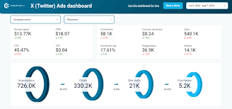
Twitter Ads dashboard

Slide 22
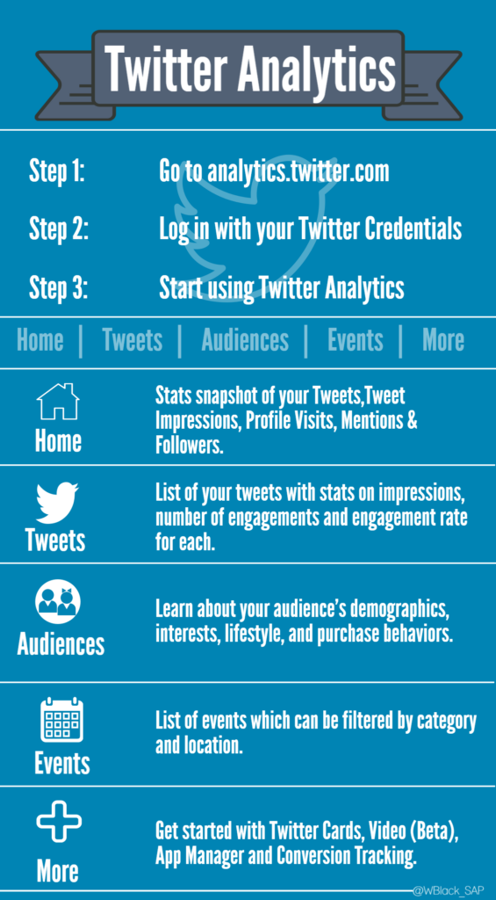
continue

Slide 23
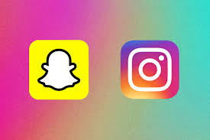
Instagram & Snapchat basics

Slide 24
Instagram
Focus:
A visual inspiration platform for sharing high-quality photos, videos, and short-form content like Reels.
Content:
Users post content to a permanent feed and Stories that disappear after 24 hours.
Features:
Includes a broad range of content formats, such as text posts, live streams, and marketplaces, along with detailed analytics for creators and businesses.
User Experience:
More public-facing, fostering a competitive atmosphere through likes and comments.
Target Audience:
Appeals to a wider audience of photographers, brands, influencers, and general users.

Slide 25
Snapchat
Focus:
Primarily a direct messaging app with a focus on ephemeral, short-lived content.
Content:
Snaps (photos/videos) and Stories disappear after 24 hours, emphasizing a transient, in-the-moment style of communication.
Features:
Known for unique creative tools, including filters, stickers, Bitmoji (customizable avatars), and friend-focused features like Streaks.
User Experience:
More intimate and personal, focused on close-friend connections and less on public curation.
Target Audience:
Predominantly used by younger teenagers and a loyal user base seeking private conversations.

Slide 26
Key Differences
Content Permanence:
Instagram features both permanent and 24-hour ephemeral content, while Snapchat's core is ephemeral.
Public vs. Private:
Instagram is a more public forum, whereas Snapchat emphasizes private, direct communication.
Platform Scope:
Instagram offers a broader platform with multiple content types (Reels, Stories, Posts), while Snapchat remains more focused on the Stories and messaging format.
Analytics:
Instagram offers more accessible analytics for a wider range of users and businesses.

Slide 27
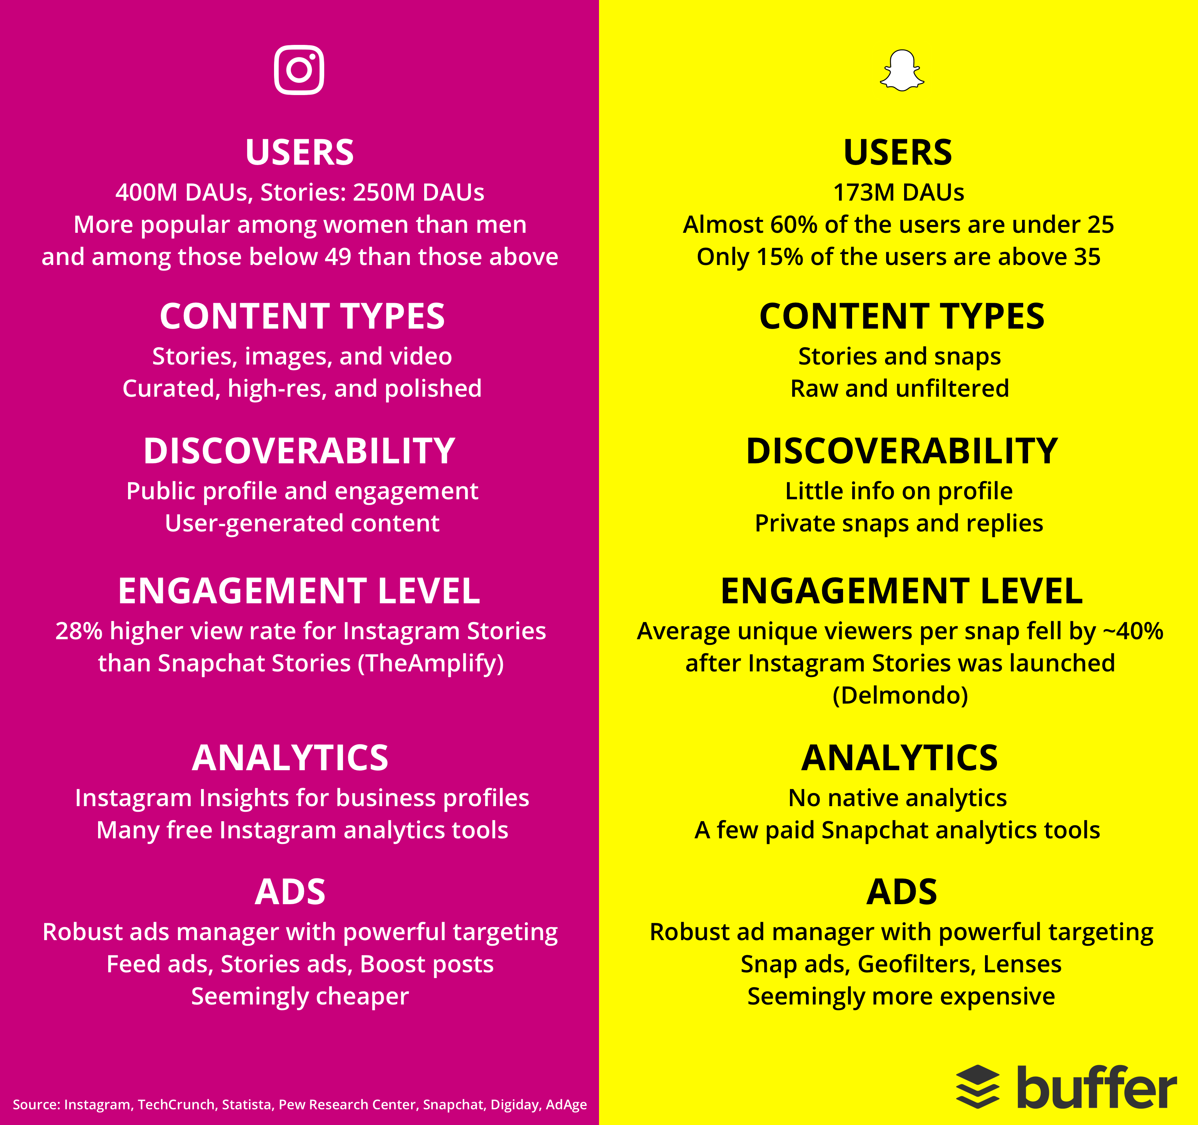
Continue

Slide 28
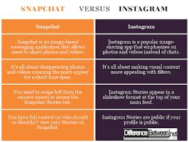
continue

Slide 29
Using Twitter for Engagement
- Live tweets and event coverage
- Replying to mentions and DMs
- Analytics: Impressions, reach, engagement rate

Slide 30
Twitter Ads Overview
- Ad types: Promoted tweets, accounts, trends
- Objectives: Engagement, traffic, installs
- Ad format examples and goals

Slide 31
Creating Twitter Ad Campaigns
- Use of Twitter Ads Manager
- Targeting: interests, location, device
- Budgeting, A/B testing
- Performance monitoring

Slide 32
Recap + Class Activity
- Draft a tweet for a product/event
- Include hashtag and image idea
- Share and discuss with the class

Slide 33
YouTube Tutorial
Title: Twitter Marketing Tutorial for Beginners
Link: https://www.youtube.com/watch?v=_3x5UrxSz5Y
Covers: Basics, Strategy, Ad Campaigns

